Slide 1
Skeleton Extraction

Slide 2
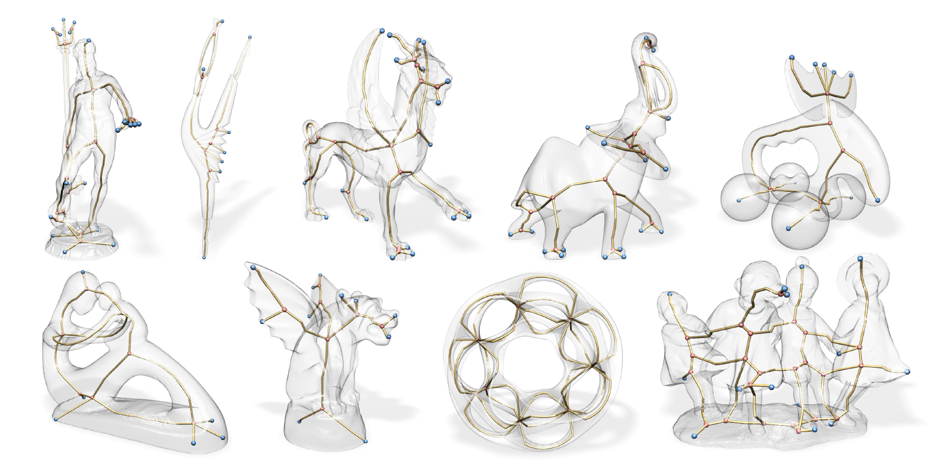
Skeleton

Slide 3
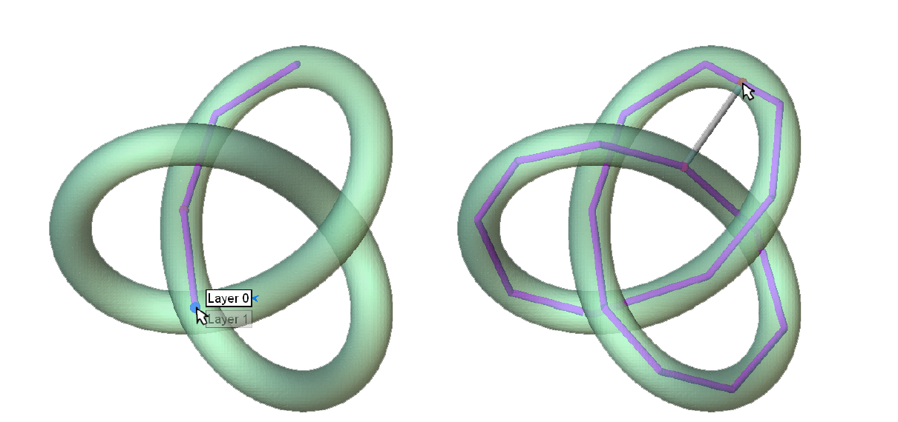
Skeleton

Slide 4
Skeleton Extraction
Automatic
Mesh Contraction
Least Square Mesh
Sketching
Blending
Depth Peeling

Slide 5
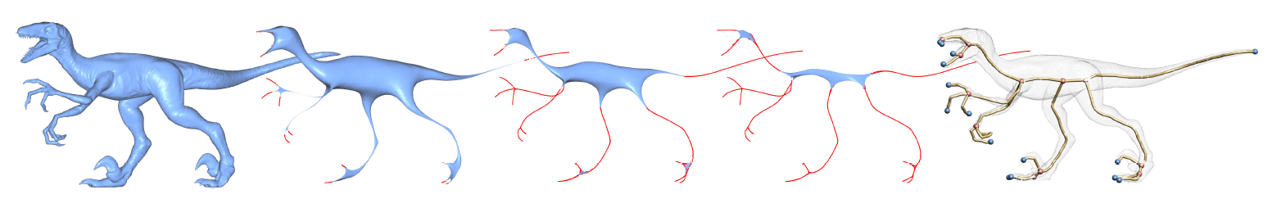
Skeleton Extraction
Mesh Contraction
Decimation Operator
Least square mesh
Mesh smoothing
Laplace operator for mesh

Slide 6
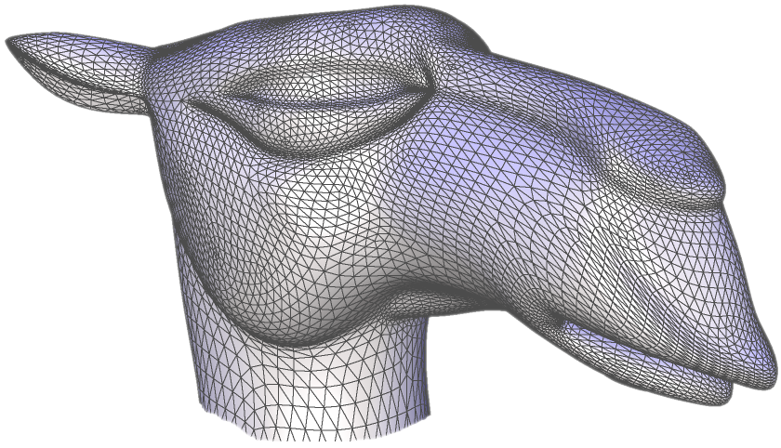
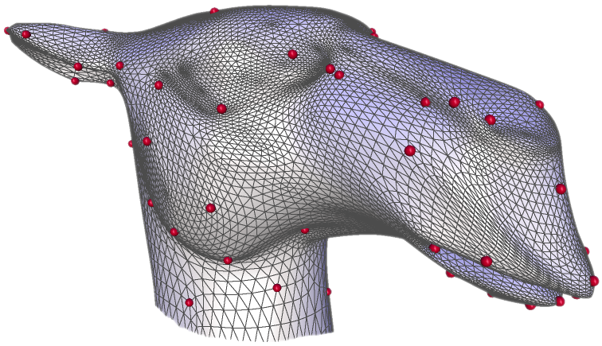
Least-squares Meshes
Enrich the connectivity by sparse set of control points with geometry
Solve a linear least-squares problem to reconstruct the geometry of all vertices(the approximated shape)

Slide 7
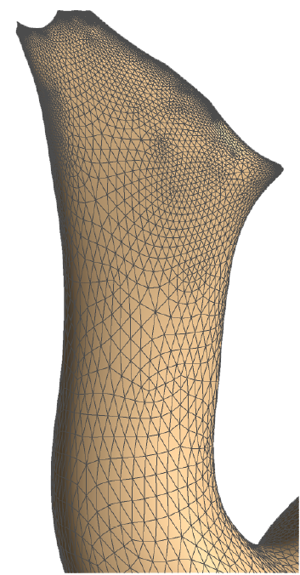
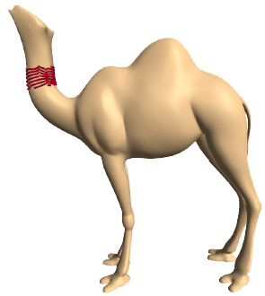
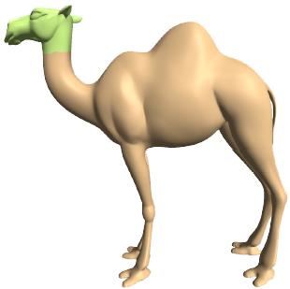
Geometry hidden in connectivity
There is geometry in connectivity

Slide 8
The linear system
We have two types of constraints:
Fairness constraint L(v_{i}) = 0 ∀i
Geometric constraint v_{j} = c_{j} j ∈ C
L is the mesh Laplacian operator:

Slide 9
Linear least-squares solution
L

Slide 10
Solving the least-squares problem
We need to solve an over-determined system:
We find the solution by solving the normal equations:
Very efficient solution by Cholesky factorization of A^{T}A:
R is upper-triangular and sparse
Once R is computed, solving for x, y, z by back-substitution:

Slide 11
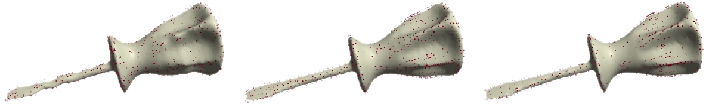
Random selection
Fast, but less effective approximation
Greedy approach
Place one-by-one at vertices with highest reconstruction error
Slow, but gives good approximation
Greedy selection combined with local error maxima
A reasonable compromise
Random selection
Greedy approach
Combined approach
1000 control points

Slide 12
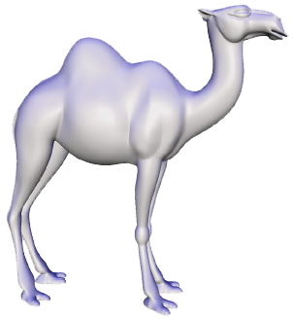
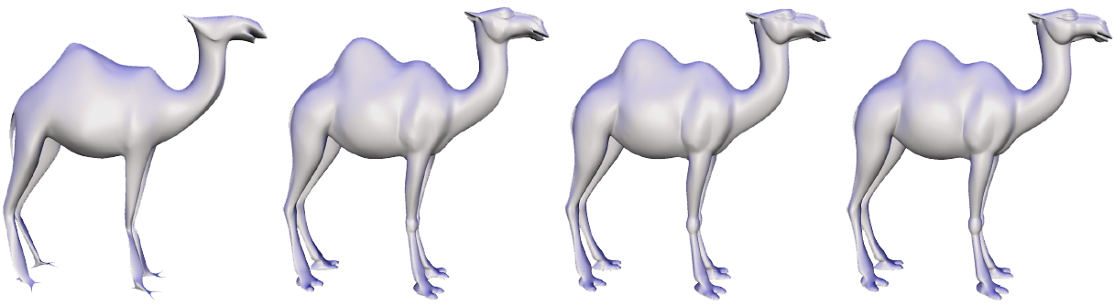
Some results – varying number of control points
Original camel
39074 vertices
100 control points
600 control points
1200 control points
3600 control points

Slide 13
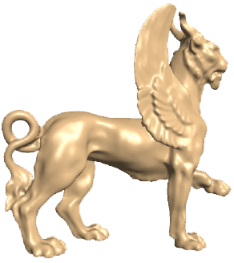
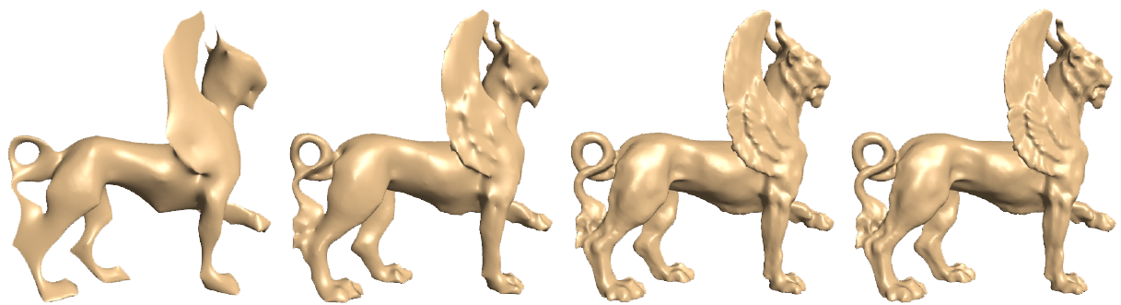
Some results – varying number of control points
Original feline
49864 vertices
100 control points
500 control points
4000 control points
9000 control points

Slide 14
Linear System Library
OpenCV
Powerful Library for image processing
Linear system also support
OpenNL
Numerical Library and support CUDA solver
Tacus
Solve Linear system

Slide 15
Ax=B
GeneralSparseMatrix GA;
GA.Create( 3, 3 );
GA.SetElement( 0, 0, 1.0 );
GA.SetElement( 0, 1, 1.0 );
GA.SetElement( 0, 2, 1.0 );
GA.SetElement( 1, 1, 2.0 );
GA.SetElement( 2, 2, 0.0 );
A

Slide 16
Ax=B
const int dim = 2;
double** B = new double*[dim]; // create 2d.
B[0] = new double[3];
B[1] = new double[3];
B[0][0] = 1.0; B[0][1] = 2.0; B[0][2] = 3.0;
B[1][0] = 6.0; B[1][1] = 7.0; B[1][2] = 8.0;

Slide 17
Ax=B
// note: 建立的 A and B memory 都將由 sls 負責管理，
// ps. A and B must allocate from heap.
// ps. GA 須轉成, stable sparse matrix.
SparseLinearSystem sls( new StableSparseMatrix(GA), B, dim );
// solving it !! A * x = B.
//-------------------------------------------------
// the solution will be stored here.
double** x = 0;
// solve it !!
bool result = GeneralSparseLSSolver::GetInstance()->Solve( &sls, x );
x[0][0]
x[0][1]
x[0][2]
x[1][0]
x[1][1]
x[2][2]
X

Slide 18
Ax=B(Least Square)
Let we have

Slide 19
Ax=B(Least Square)

Slide 20
Ax=B(Least Square)

Slide 21
Ax=B(Least Square)
GeneralSparseMatrix GA;
const int dim = 2;
double** B = new double*[dim]; // create 2d.
SparseLinearSystem sls( new StableSparseMatrix(GA), B, dim );
bool result = LeastSquareSparseLSSolver::GetInstance()->Solve( &sls, x );

Slide 22
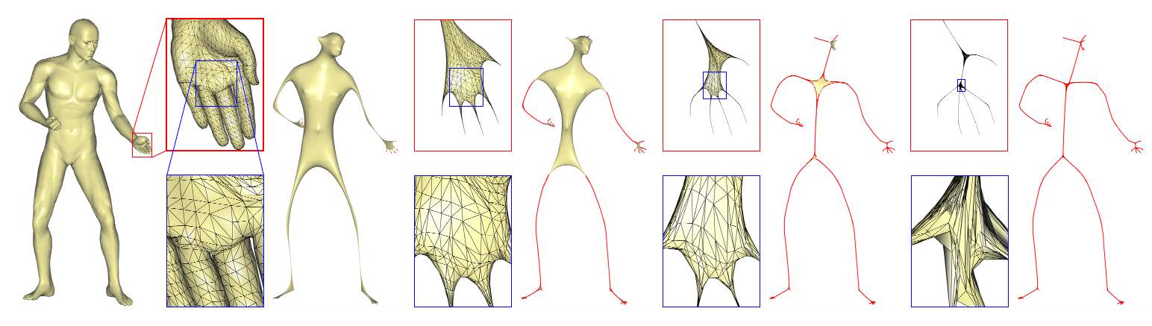
Least square mesh smoothing
We using all vertices as control points, and iterative smooth mesh.
Conformal weight

Slide 23
Least square mesh smoothing
Contraction Energy =
Attraction Energy =
We solve this system with soft constrain.

Slide 24
Skeleton Extraction using Least square mesh
Solve
Update and where and are the current and the original one-ring areas, respectively.
Compute the new Laplace operator with the current vertex position

Slide 25
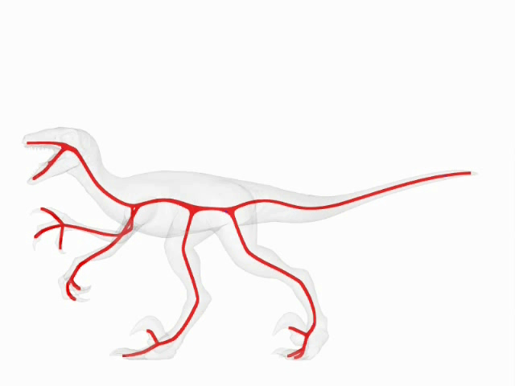
Connectivity Surgery Example

Slide 26
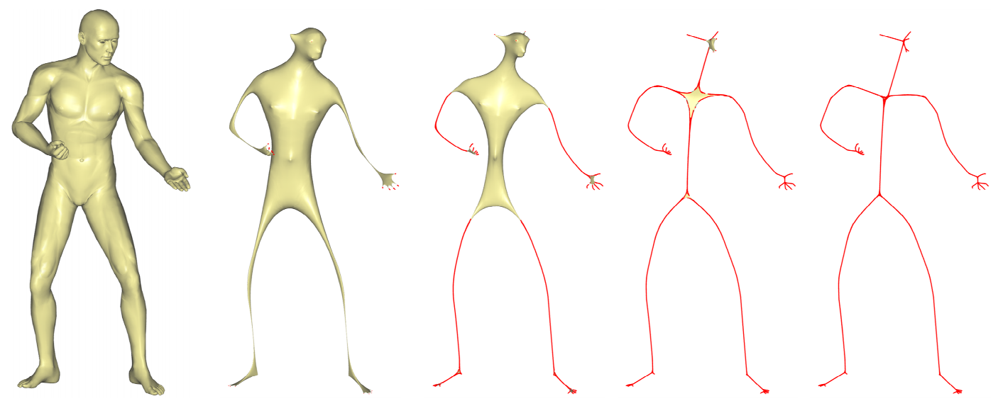
Geometry Contraction
Iteratively apply curvature-flow Laplacian smoothing
removes geometric details and noise
moves vertices along curvature normal directions

Slide 27
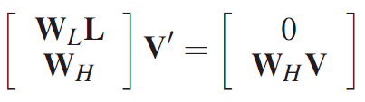
Geometry Contraction
We use implicit updating scheme
Constrain the normal flow
Current mesh vertices serve as positional constraints
Solve the sparse linear system:
Laplace
operator
Positional constraints

Slide 28
Geometry Contraction
Position Constraints
Avoid degenerate solutions
Constrain all the vertices to their current positions
Act as attraction constraints
Rows of Laplacian system
Provide the forces to contract the mesh
Act as contraction constraints

Slide 29
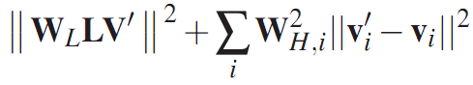
Geometry Contraction
Least-squares minimization
Solving the system once cannot collapse the model into a 1D shape
We need iterative contraction
Laplacian
System
Position constraints

Slide 30
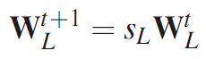
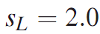
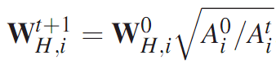
Iterative Geometry Contraction
For each iteration
Increase W_{L} to increase the collapsing speed
Update W_{H} according to local contraction degree to avoid over contraction
Local contraction ratio
Notes:
(decrease?) No, W_H may be increased or decreased

Slide 31
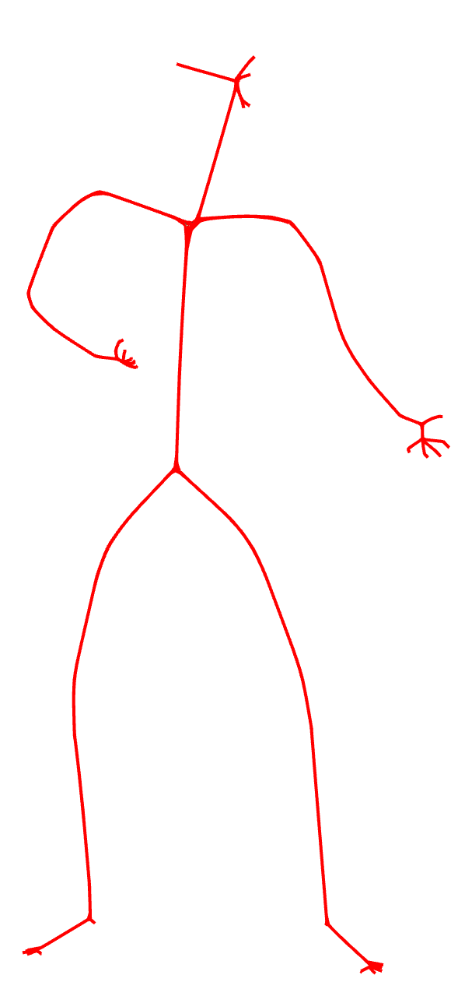
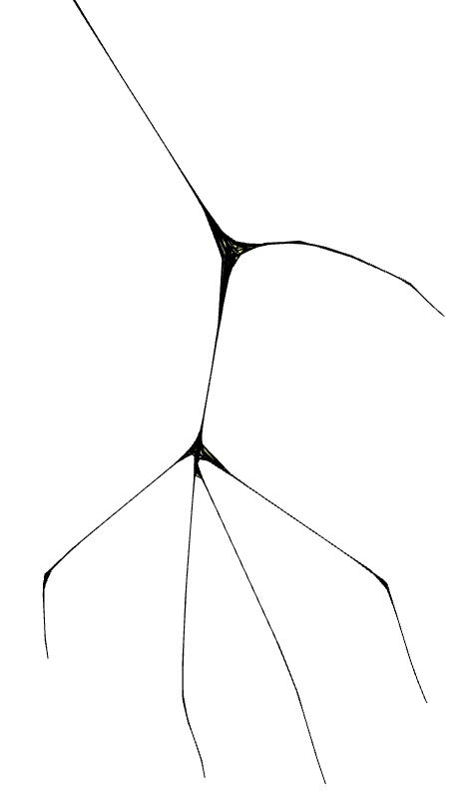
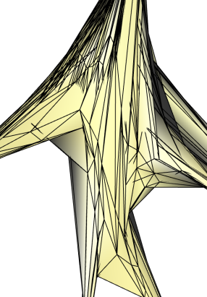
Connectivity Surgery
Contracted mesh
Approximately zero volume
Original mesh connectivity
Need to simplify the contracted mesh into a 1D graph

Slide 32
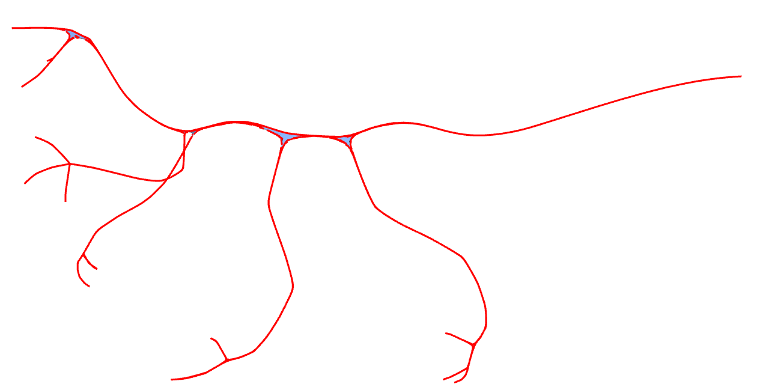
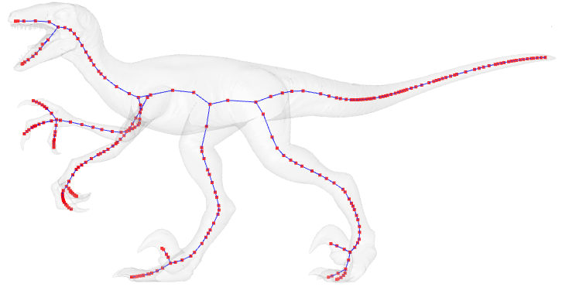
Connectivity Surgery
Perform half-edge collapses to remove contracted faces
Greedy algorithm
Collapses the edge with the minimum cost
No post-connecting

Slide 33
Connectivity Surgery
Shape Cost
Like QEM simplification of Garland and Heckbert
QEM uses face-based distance measure
We use edge-based distance measure
All faces are degenerate
Measure total squared distance from remaining vertices to original edges

Slide 34
Connectivity Surgery
Sampling Cost
To avoid over-simplification in straight regions
penalizes edge collapses that generate long edges
Measure total travelling distance of involved edges

Slide 35
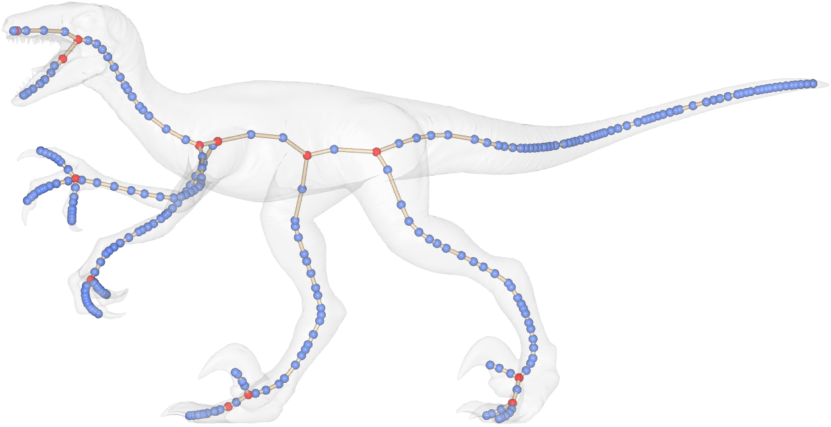
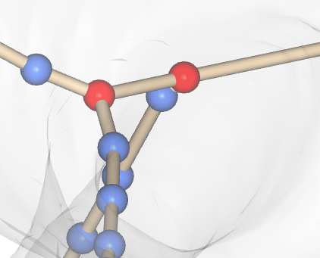
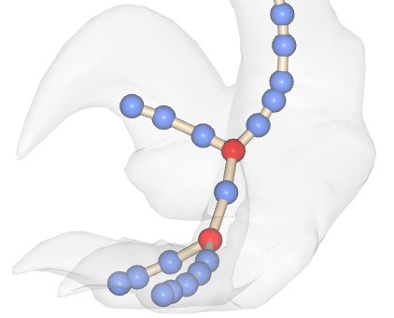
Connectivity Surgery Result
complex branching structure
off centered skeletal nodes

Slide 36
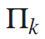
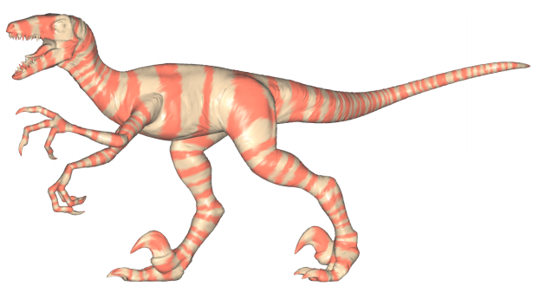
Embedding Reﬁnement
Centering skeletal nodes
Exploit the skeleton-mesh mapping
Compute average displacement from skeleton node to local center
junction node
regular node
Notes:
pi_k : set of vertices that collapsed to the same skeleton node k
For each mesh region, computing average displacement of boundary vertices

Slide 37
Embedding Reﬁnement
Simplify branching structure
merge each junction node with adjacent node if centeredness is improved
complex branching structure
Notes:
By computing average displacement of boundary vertices of each mesh region

Slide 38
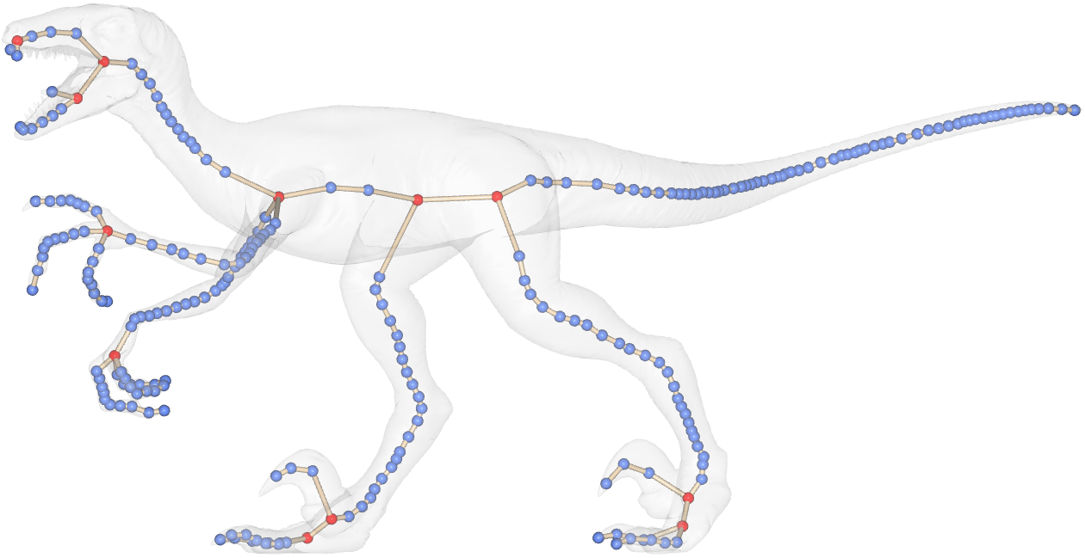
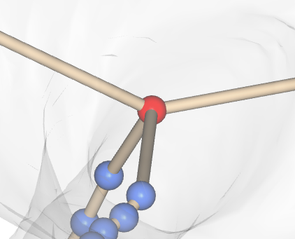
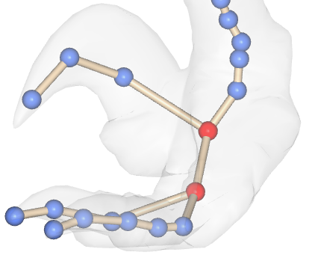
Embedding Reﬁnement Result
simplified branching structure
centered skeletal nodes

Slide 39
Result

Slide 40
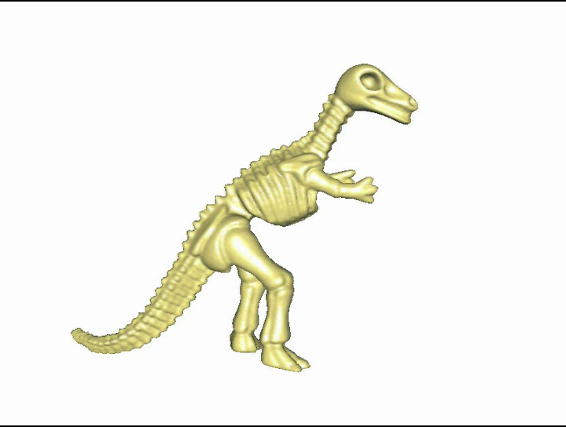
Skeleton Sketching
Depth peeling

Slide 41
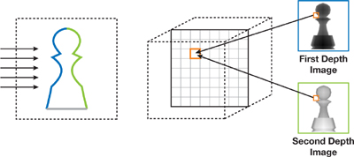
Depth peeling
Using Fragment Shader to simulate depth image

Slide 42
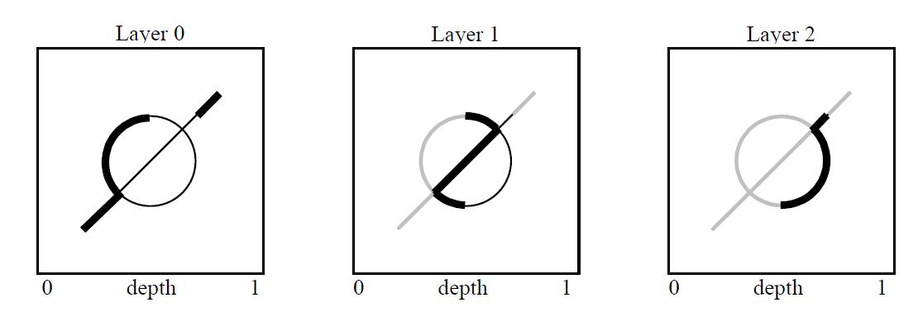
Depth peeling
Fragment shaer would help us to delete non-necessary layer
char _fp_peel[] =
"!!ARBfp1.0\n"
"OPTION ARB_fragment_program_shadow;\n"
"TEMP R0;\n"
"TEX R0.x, fragment.position, texture[0], SHADOWRECT;\n"
"ADD R0.x, R0.x, -0.5;\n"
"KIL R0.x;\n"
"MOV result.color, fragment.color;\n"
"END\n";

Slide 43
Peeling Layer
static tex_object_rectangle ztex, rgba_layer[MAX_LAYERS];
static arb_fragment_program fp_peel
//------------------------------------------------------------------------
ztex.bind();
if (l > 0) {
glEnable(GL_FRAGMENT_PROGRAM_ARB);
fp_peel.bind();
}
glDisable(GL_CULL_FACE);
m_scene_Mesh->Render_Solid();
glEnable(GL_CULL_FACE);
glDisable(GL_FRAGMENT_PROGRAM_ARB);
ztex.bind();
glCopyTexSubImage2D(GL_TEXTURE_RECTANGLE_NV, 0, 0, 0, 0, 0, scene_width, scene_height);
glFinish();
// copy the RGBA of the layer
rgba_layer[l].bind();
glCopyTexSubImage2D(GL_TEXTURE_RECTANGLE_NV, 0, 0, 0, 0, 0, scene_width, scene_height);

Slide 44
Peeling Layer
//---------------Texture Buffer 初始化---------------//
void DP_COM::Set_BufferObj( int scene_width, int scene_height )
{
ztex.bind();
zbuf = new GLuint [ scene_width * scene_height ];
glTexImage2D(GL_TEXTURE_RECTANGLE_NV, 0, GL_DEPTH_COMPONENT, scene_width, scene_height, 0,
GL_DEPTH_COMPONENT, GL_UNSIGNED_INT, zbuf);
for(int i=0; i < MAX_LAYERS; i++)
{
rgba_layer[i].bind();
glTexImage2D(GL_TEXTURE_RECTANGLE_NV, 0, GL_RGBA8, scene_width, scene_height, 0,
GL_RGBA, GL_UNSIGNED_BYTE, zbuf);
rgba_layer[i].parameter(GL_TEXTURE_MIN_FILTER, GL_NEAREST);
rgba_layer[i].parameter(GL_TEXTURE_MAG_FILTER, GL_NEAREST);
}
delete [] zbuf; glProgramEnvParameter4fARB(GL_FRAGMENT_PROGRAM_ARB, 0, 0.6, 0.6, 0.6, 0.6);
ClearBuffer(); m_pZBuffer = new float[scene_width * scene_height * MAX_LAYERS]; m_ValidBuffer = new bool [scene_width * scene_height];
}

Slide 45
Peeling Layer
void DP_COM::Peeling_layer( int scene_width, int scene_height, int layer, Tri_Mesh* mesh )
{
glClear(GL_COLOR_BUFFER_BIT | GL_DEPTH_BUFFER_BIT);
ztex.bind();
if (layer > 0) {
glEnable(GL_FRAGMENT_PROGRAM_ARB);
fp_peel.bind();
}
glDisable(GL_CULL_FACE);
mesh->Render_Solid();
glEnable(GL_CULL_FACE);
glDisable(GL_FRAGMENT_PROGRAM_ARB);
ztex.bind();
glCopyTexSubImage2D(GL_TEXTURE_RECTANGLE_NV, 0, 0, 0, 0, 0, scene_width, scene_height);
glFinish();
// copy the RGBA of the layer
rgba_layer[layer].bind();
glCopyTexSubImage2D(GL_TEXTURE_RECTANGLE_NV, 0, 0, 0, 0, 0, scene_width, scene_height);
glReadPixels(
0, 0,scene_width, scene_height, GL_DEPTH_COMPONENT,GL_FLOAT,
&m_pZBuffer[scene_width * scene_height * layer]);
}

Slide 46
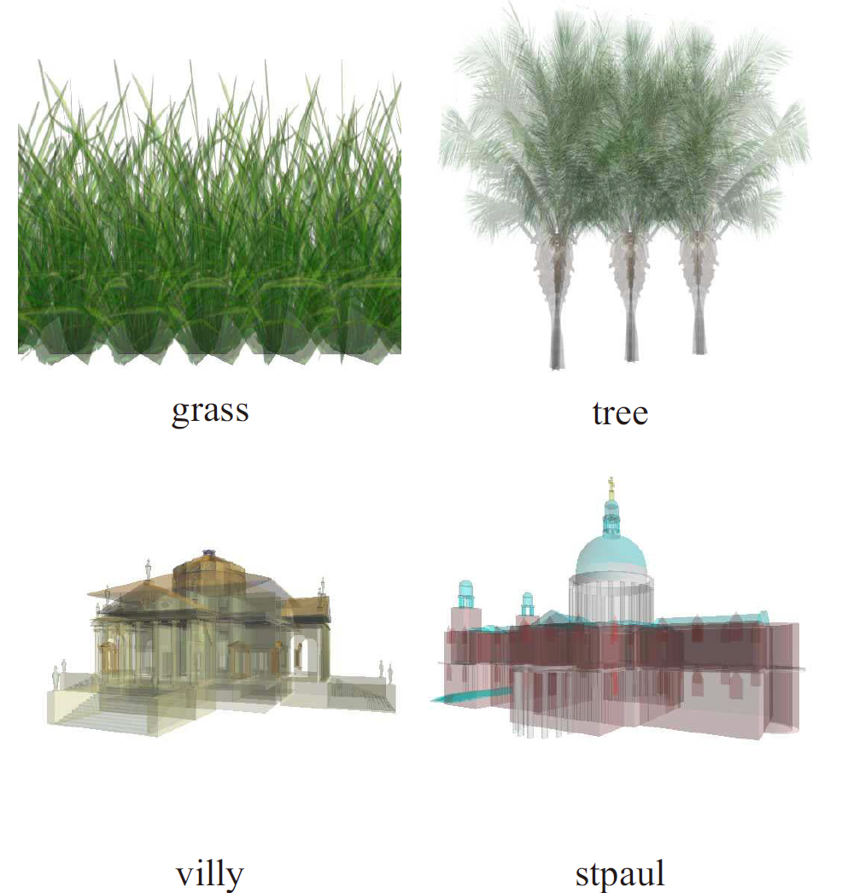
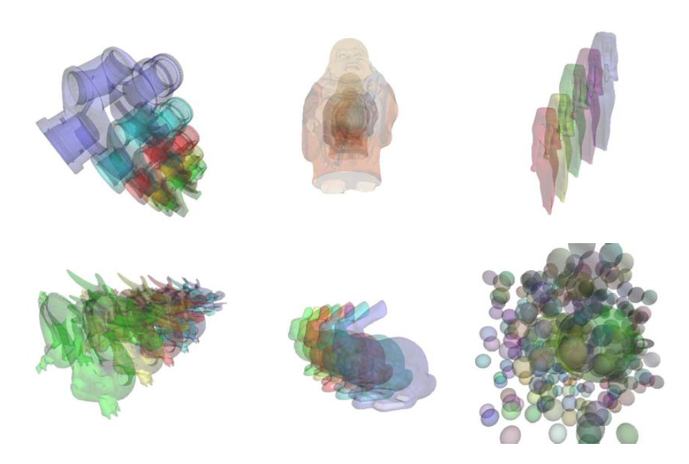
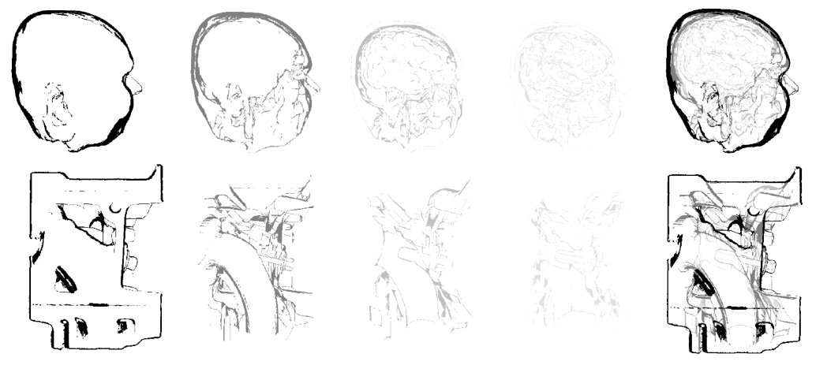
The application of Depth Peeling

Slide 47
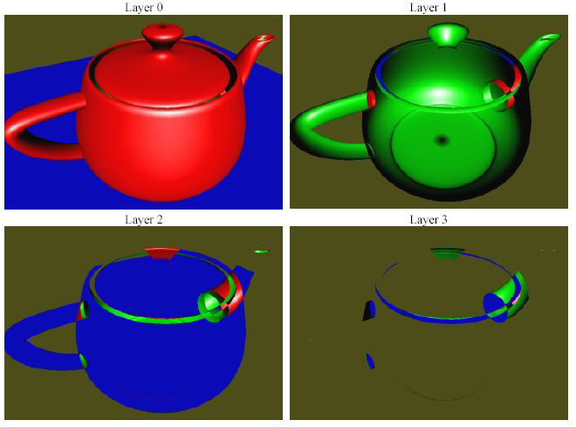
Depth peeling
http://developer.download.nvidia.com/SDK/9.5/Samples/DEMOS/OpenGL/layerz_3x.zip

Slide 48
Linear System
U_{i} = Σ a_{i,j}U_{j}
j ∈ N_{i}
i
∀ i,j ai,j > 0
j₁
The border is mapped to
a convex polygon
j…
j₂
[Tutte], [Floater]

Slide 49
Linear System
F(p)= Σ p_{i} - Σ a_{i,j}p_{j}
2
i
i
j ∈ N_{i}
j₁
j…
j₂
[Mallet], [Kobbelt], …

Slide 50
Linear System
F = sum of terms, attached to neighborhoods
Parameterization
[Haker00]
[Levy02]
Curv. Estimation
[Cohen-Steiner 03]
Texture mapping
[Levy01]
Discrete fairing
[Levy03]
Discrete fairing
[Kobbelt98, Mallet95]
Parameterization
[Desbrun02]
Deformations
[CohenOr], [Sorkine]
[Eck]

Slide 51
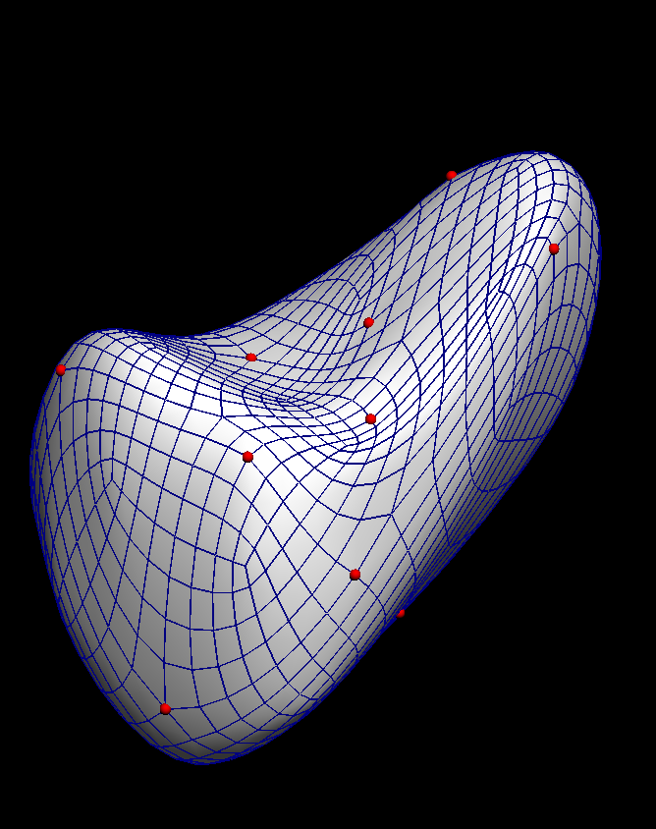
Linear and Quadratic DGP Removing degrees of freedom
2
F(x) = A x - b
2
xf
xl
F(xf) =
[ Af Al] - b

Slide 52
Linear and Quadratic DGP Removing degrees of freedom
2
2
F(x_{f}) = A.x - d = A_{l}.x_{l} + A_{f}.x_{f} - d
F(x_{f}) minimum
A_{f}^{t}.A_{f}.x_{f} = A_{f}^{t}.d - A_{f}^{t}A_{l}.x_{l}
}
}
M.x = b
The problem: (1) construct a linear system
(2) solve a linear system

Slide 53
Linear and Quadratic DGP
inline int solve_conjugate_gradient(
const SparseMatrix &A, const Vector& b, Vector& x,
double eps, int max_iter
){
int N = A.n() ;
double t, tau, sig, rho, gam;
double bnorm2 = BLAS::ddot(N,b,1,b,1) ;
double err=eps*eps*bnorm2 ;
mult(A,x,g);
BLAS::daxpy(N,-1.,b,1,g,1);
BLAS::dscal(N,-1.,g,1);
BLAS::dcopy(N,g,1,r,1);
while ( BLAS::ddot(N,g,1,g,1)>err && its < max_iter) {
mult(A,r,p);
rho=BLAS::ddot(N,p,1,p,1);
sig=BLAS::ddot(N,r,1,p,1);
tau=BLAS::ddot(N,g,1,r,1);
t=tau/sig;
BLAS::daxpy(N,t,r,1,x,1);
BLAS::daxpy(N,-t,p,1,g,1);
gam=(t*t*rho-tau)/tau;
BLAS::dscal(N,gam,r,1);
BLAS::daxpy(N,1.,g,1,r,1);
++its;
}
return its ;
}
Only simple
vector ops (BLAS)
Complicated ops:
Matrix x vector
(see paper)

Slide 54
Example - Linear System
nlSolverParameteri(NL_NB_VARIABLES, 2*nb_vertices) ;
nlSolverParameteri(NL_LEAST_SQUARES, NL_TRUE) ;
nlSolverParameteri(NL_MAX_ITERATIONS, 5*nb_vertices) ;
nlSolverParameterd(NL_THRESHOLD, 1e-10) ;
nlBegin(NL_SYSTEM) ;
mesh_to_solver() ;
nlBegin(NL_MATRIX) ;
setup_lscm() ;
nlEnd(NL_MATRIX) ;
nlEnd(NL_SYSTEM) ;
nlSolve() ;

Slide 55
Example - fix variable
for(unsigned int i=0; i<mesh_->vertex.size(); i++) {
Vertex& it = mesh_->vertex[i] ;
double u = it.tex_coord.x ;
double v = it.tex_coord.y ;
nlSetVariable(2 * it.id , u) ;
nlSetVariable(2 * it.id + 1, v) ;
if(it.locked)
{
nlLockVariable(2 * it.id ) ;
nlLockVariable(2 * it.id + 1) ;
}
}

Slide 56
Example - one row
nlBegin(NL_ROW) ;
nlCoefficient(u0_id, -a+c) ;
nlCoefficient(v0_id, b-d) ;
nlCoefficient(u1_id, -c) ;
nlCoefficient(v1_id, d) ;
nlCoefficient(u2_id, a) ;
nlEnd(NL_ROW) ;

